Slide 1
Implementing the CCSS
Notes:
8:30-8:40
Introductions & quick background
*SB-CEU’s - must sign in and out all 3 sessions to receive *mention yellow cards for requirements
*3 sessions. January 31st and April 12th other meeting dates
*Parking lot for questions
On a notecard write down 3 words that strike a chord with you from this word splash.
When I say go… Stand up, find at least two people that wrote down one of the same words as you.
Can’t be from the same school as you
Introduce yourself & your school
One thing that you hope to get from todays session

Slide 2
Group Norms
Participate fully/actively
Listen for understanding
Encourage all ideas and voices
Honor time commitments
Notes:
8:50-8:55
Take one minute to talk at your tables and be ready to share: What might someone want added to this list that would help them to be more productive in our session? Or something they might be uncomfortable
Add to poster paper

Slide 3
Today’s Goal
Explore with your colleagues the Standards for Content and Practice for Mathematics
Know the Critical Areas for your grade level to help focus your instruction
Identify content entering and leaving your grade level
Begin to consider how these new Standards are likely to impact your classroom practices
Notes:
8:55-9:00
Turn & talk to a neighbor: Based on these goals, what do you think someone from the back of the room will take back and use in their classroom?

Slide 4
Buttons Task
You and your partner need:
  One die (number cube)
  Bag of buttons
  Strip of paper colored
  Two pieces of paper
With your partner, fold your strip in half and color one side red and one side blue.
Choose which partner will be red and which will be blue.
Notes:
9:00-9:30
We will be looking at our documents today in depth, but want to engage you in a task you can take back to your class that demonstrates the essence of what the CCSS are about.
LAUNCH: Practice with buttons each partner & give support. May need to do this on several occasions with students. (3 min)
EXPLORE: (7 min)
Red partner roll die& make a set of buttons on your side that equals you rolled (Support your partner)
Blue partner roll die& make a set of buttons on your side that equals you rolled
Blue partner on your paper: pick up the red marker & write the number of buttons on the red side
pick up the blue marker & write the number of buttons on the blue side
Raise your hand if you know a way we can show joining , putting together, two sets?
Red partners: Make it fun “Whoosh” when you bring them together.
Blue partners: Using the purple marker write the number of buttons you have total (all the buttons put together)
Repeat * We are going to do this for 2 min. Record mention want to repeat until students are comfortable
Have sets of students go up to record on chart paper during the 2 minutes
5 min: Red & blue buttons are called addends – say that with me ready - say it with me in a low voice – say with me in a high voice
Read rows of chart with several volunteers
Demonstrate how to write entries as addition sentences
Repeat again writing addition sentences
3 + 4 = 7 and 4 + 3 = 7 using predictions
2 + 5 = 7 and 5 + 2 = 7 using predictions
5 min: Handout Sums to 10 chart: Use 2 + 5 = 7 number sentence
Put your finger on the red 2 – this is the addend (number of red buttons you just used)
Put your finger on the blue 5 – this is the addend (number of blue buttons you just used)
Bring together and should be the total buttons (purple)
5 min Summary questions: Process at tables and then share out. ***Toughest piece.

Slide 5
Key Characteristics
Focus and coherence
Focus on key topics at each grade level
Coherent progressions across grade levels
Balance of concepts and skills
Content standards require both conceptual understanding and procedural fluency
Mathematical practices
Foster reasoning and sense-making in mathematics
Notes:
10:05-10:20 INFORMATION BURST
Natural developmental progressions: Children learn to crawl, walk, run, skip and jump.
Progressions allow teachers to build the mathematics of children- the thinking of children as it develops naturally – Doug Clements
5

Slide 6
Standards for Mathematical Practice
Make sense of problems and persevere in solving them
Reason abstractly and quantitatively
Construct viable arguments and critique the reasoning of others
Model with mathematics
Use appropriate tools strategically
Attend to precision
Look for and make use of structure
Look for and express regularity in repeated reasoning
Notes:
Eight standards / Span Grade levels
Since they are defined as “standards” they are assessable
This is a big change from our current standards where our assessments were a one to one correspondence – making the standards more of a checklist.
Discuss briefly Impact on MEAP - 2014/2015 *Highlight that they have the first group of students that will take the test.
Turn & talk to your neighbor “Defend Jason Zimba’s argument that these are the “Habits of Mind” that we want our students to have when they leave school.
Again, ask for any clarifying questions.

Slide 7
Key Characteristics
Focus and coherence
Focus on key topics at each grade level
Coherent progressions across grade levels
Balance of concepts and skills
Content standards require both conceptual understanding and procedural fluency
Mathematical practices
Foster reasoning and sense-making in mathematics
Notes:
Focus & Coherence: Writers of the CC have developed a set of videos that express their intent.
Balance of concepts & skills: The standards do have a call for higher cognitive demand that require both conceptual understanding & procedural fluency This is made possible with standards that are more focused – not a huge checklist of topics to complete standards are interconnected.
Research tells us we don’t want ideas to exist in isolation. We want to make as many connections as possible.
7

Slide 8
Traditional U.S. Approach
 | K 12
Number and Operations
Measurement and Geometry
Algebra and Functions
Statistics and Probability
Notes:
This slide represents the traditional US approach K-12. Notice that the strands all start in K and end it 12th grade without anything distinguishing, importance, focus or age appropriateness.
8

Slide 9
Common Core Domains, K–8
K |  | 1 | 2 | 3 | 4 | 5 | 6 | 7 | 8 | HS
Counting & Cardinality
Number and Operations in Base Ten |  |  |  |  |  |  | Ratios and Proportional Relationships |  |  | Number & Quantity
 |  |  |  | Number and Operations – Fractions |  |  | The Number System
Operations and Algebraic Thinking |  |  |  |  |  |  | Expressions and Equations |  |  | Algebra
 |  |  |  |  |  |  |  |  | Functions | Functions
Geometry |  |  |  |  |  |  |  |  |  | Geometry
Measurement and Data |  |  |  |  |  |  | Statistics and Probability |  |  | Statistics & Probability
Notes:
CCSS Domain represent progressions that unfold across grade levels.
At your tables talk about what you notice.
I heard people saying…
* Age appropriate
*Start & end to pieces
*Coherence allows students opportunities to makes connections among mathematical ideas within a grade level & across grade levels.
*Moves us from seeing our standards as a checklist of ideas to be covered to progression of ideas that build on one another.
I will be focusing on these progressions in our sessions to help you understand how content unfold within Kindergarten and how it prepares students for the next level.
9

Slide 10
Critical Areas
There are typically two to four Critical Areas for instruction in the introduction of each grade level
They bring focus to the standards by grouping and summarizing the big ideas to guide instruction
Notes:
10:20-10:30
The Critical Areas are the lens that you should view your instruction through each day. Is your curriculum/instruction focused on Critical Areas?

Slide 11
Getting to know the Critical Areas
Read the critical areas for your grade level
Use a sticky note to stop and jot at least two things that will impact your practice
Pick one of your sticky notes to share out at your table
Notes:
Show them which document is CCSS document
Make sure everyone at your table has found the Critical Areas for Kindergarten on page 9.
5 min: Read
5 min: Share at tables one sticky note.
3 min: I heard someone say… Something that helped me…. Something that made me feel at ease…. Something that I have a question about….

Slide 12
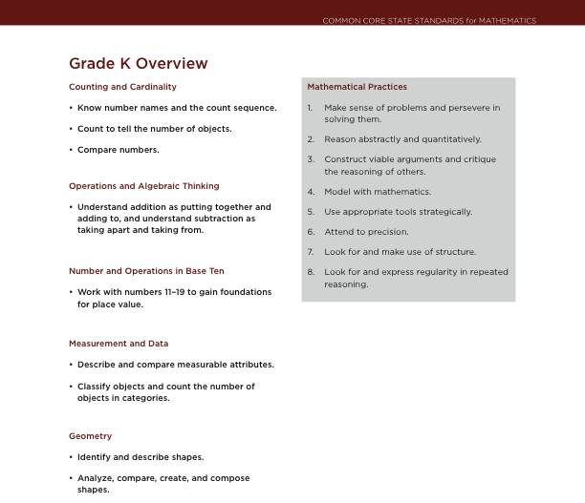
Notes:
Pg. 10 Overview page which includes
Both sets of standards
domains & clusters
12

Slide 13
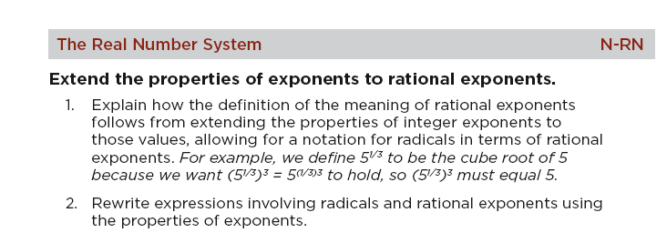
Design and Organization
Content standards define what students should understand and be able to do
Clusters are groups of related standards
Domains are larger groups that progress across grades
Domain
Cluster
Standard
Notes:
13
13
10:30 – 10:45
Quick overview how to read. Have participants look at page 11
5 min: Read & jot down any notes, questions/concerns you have
5 min: Pick up standards and find someone at another table to share your notes.
5 mins: Q & A about standards. Appendix models.
10:45 – 11:00
Crosswalk documents.
Find in binders
This is a Michigan document
I know that I am guilty of skipping Intros & Appendices of documents, but there is some really important info so I wanted to carve out time for you to read now.
Read first page.
13

Slide 14
Critical Areas vs. Focal Points
Notes:
On page 2 of crosswalk document
1st – Notice MP on top of page
2nd – Section that shows the tight alignment of our current focal pts to new critical areas.
14

Slide 15
Progressions
Notes:
The video mentioned the progressions of mathematical ideas that move from grade to grade. This page is an overview of how the progressions build in each grade level.
Before, your grade level and next grade level so you can see how the skills are building further skills.
Great place for you to assess how what you are teaching fits in the puzzle.
More details need to be filled in, which will be part of our work in these three sessions.
Discuss the progression documents.
15

Slide 16
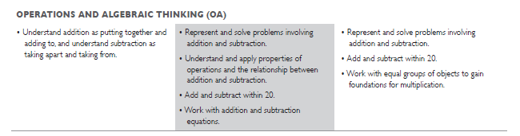
Kindergarten teachers: Fluently add and subtract within 5.
1st grade teachers: Add and subtract within 20, demonstrating fluency for addition and subtraction within 10.
2nd grade teachers: Fluently add and subtract within 20 using mental strategies. By end of Grade 2, know from memory all sums of two one-digit numbers.
Notes:
Demonstrate Progression at different levels.
2 minutes.
Turn & talk at your tables: How might these learning progressions change the way we interact with our colleagues?
16

Slide 17
Crosswalk Documents
Crosswalk documents are organized by current focal points
  Common Content
  Content that is Different
Notes:
11:00 – 11:30
COMMON CONTENT:
Start on page 5 – left side is the current GLCE’s & right side is the CCSS throughout the entire document. * Hold up left hand – What does it represent?
Notice at the top the Focal point & Critical Area. NEXT SLIDE– first thing listed.
There will be a section of common content / content that is different for each section. Look through now and notice those headings.
Assign tables sections to create a poster that represents the subtle changes vocabulary, scope. Remember that the CCSS are more focused than our past GLCE’s so you may notice that the scope of numbers may change.
Group presentations.
15 min – assigned a section of common content – record subtle differences.
15 min – present. 2 groups for each section.

Slide 18
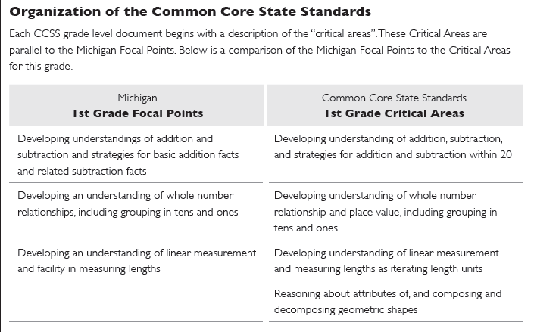
Critical Areas vs. Focal Points
Notes:
18

Slide 19
CCSS Sample Activities
What content are students learning in the activity?
What mathematical practices would students be using in the activity?
Notes:
12:00 – 12:30
You are going to have 20 minutes to participate in some hands on activities. The purpose of this time is to identify the content and mathematical practice standards that you are engaged in.
At each table is an activity with an instruction sheet
Not intended that this is what you would give your students * we will be coming back to these activities in another session to talk about what would these activities look like with our students. Also I will give you the website that these exact sheets came from, so don’t feel the need to take notes on what the activity was about.
Turn & tell you neighbor what your goal is in the activity.
5 minutes at each station to identify content & practice standards. Need your practice standards & your content.
Show how to code standards.
We will spend 10 min sharing out.
STATIONS:
Concentration cards
Representing Numbers in 3 different ways
Unifix towers
Facts of five
Shake five and spill
Five frame flash

Slide 20
Shifting Content
1st Grade -> Kindergarten
Fluently add & subtract within 5
Notes:
12:35-12:45
Look at Kindergarten crosswalk documents pg. 6
Content that is different (Whole Group)
Turn & tell you neighbor what the left side represents in the crosswalks.
Turn & tell you neighbor what the right side represents in the crosswalks.
We are now going to look at the content that is different. Content coming in to Kindergarten & content leaving Kindergarten. Feel free to use highlighters, sticky notes or just write in your documents.
12:45-1:10
If possible, in district groups or with partners: make a representation of the important points that you will need to take back to share with your other kindergarten teachers or with 1st . Feel free to use poster paper, note paper, colored paper on the tables.
Warning * We will share these with each other in some way. Pick out colored paper.

Slide 21
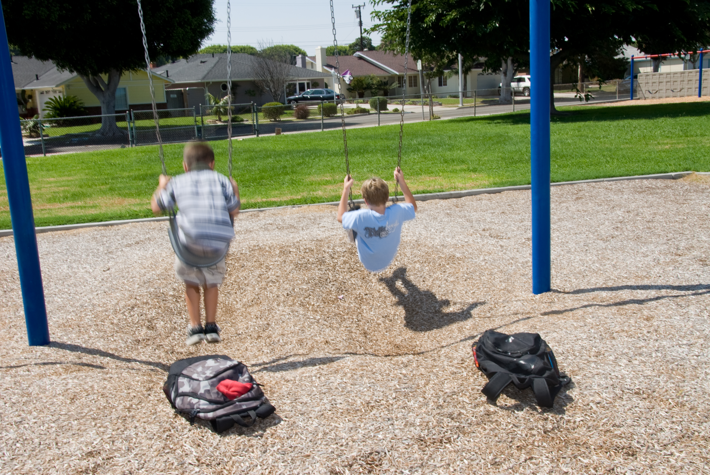
BREAK
Notes:
1:15-1:30

Slide 22
Subitizing
Instantly seeing how many
Introduces basic ideas of:
  Cardinality
  “How many”
  More
  Less
  Beginning arithmetic
Notes:
1:30 – 1:40 Dot plate activity.
At 3 yrs: children can distinguish between collections of one or more objects.
At 4: distinguish two, then three specifically & recognize collections up to four
This is when subitizing& counting become connected
Benefits
*different arrangements suggest different views of that number
1:40 – 2:05 Overview & Identify Standards
2:05-2:20: Read Clements article. Pay attention to things that you need to be careful of when implementing subitizing activities in your classroom.
2:20-2:30: Process with groups of 2 or 3. I heard….
2:30-2:45 Dot plate activities sheet in activity section

Slide 23
Representation Stars
Oral
Language
Verbal
(written and oral)
Real-World
Situations
Pictures
Contextual
Geometric/
Graphical
Written
Symbols
Manipulative
Models
Symbolic
Tabular
Adapted from Van de Walle, J.A. (2004) Elementary and Middle Schools Mathematics: Teaching Developmentally.
23
Notes:
2:45-2:50

Slide 24
The Nature of Tasks Used in the Classroom …
Will Impact Student Learning!
Tasks as
they appear
in curricular
materials
Student
learning
24
Notes:
24
First, as we have discussed in the overview session, we need to pay attention to what tasks we select because the nature of the tasks will
impact student achievement, but

Slide 25
But, WHAT TEACHERS DO with the tasks matters too!
The Mathematical Tasks Framework
Tasks as
they appear
in curricular
materials
Tasks as
enacted by
teachers and
students
Tasks as
set up by
teachers
Student
learning
Stein, Grover & Henningsen (1996)
Smith & Stein (1998)
Stein, Smith, Henningsen & Silver (2000)
25
Notes:
25
Having good tasks is only part of the story, how a teacher uses the task can significantly impact students’ learning
opportunity
Tasks are important, but teachers also matter!
Teacher actions and reactions, that is their instructional decisions in the classroom, …
influence the nature and extent of student engagement with challenging tasks,
and
effect students’ opportunities to learn from and through task engagement. In particular, the way teachers choose to use tasks can significantly influence the opportunities students have to develop skills associated with the mathematical practices.

Slide 26

Questions?
Please contact:
Renee Floyd Dalton, Mathematics Consultant
Hot Springs High School
cfloyd@hotspringspride.com

Slide 27
Today’s Goal
Explore with your colleagues the Standards for Content and Practice for Mathematics
Know the Critical Areas for your grade level to help focus your instruction
Identify the content entering and leaving your grade level
Begin to consider how these new Standards are likely to impact your classroom practices
Notes:
As fill out Ticket out Door keep today’s goals in mind.

